Slide 1

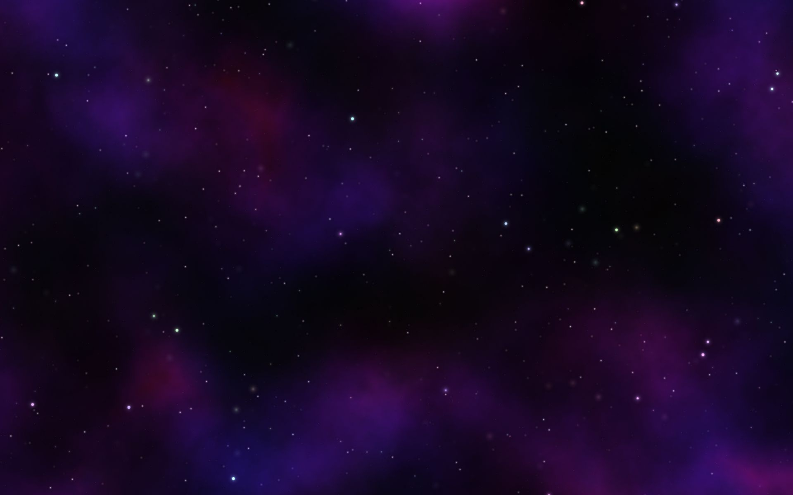
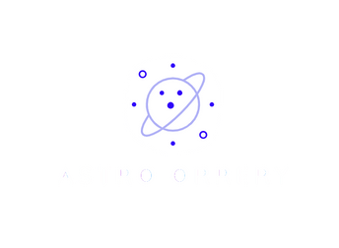



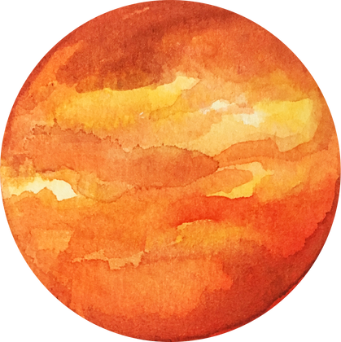
ASTRO ORRERY
An Orrery Web App that Displays Near-Earth Objects

Slide 2

Introductions
ASTRO ORRERY, an interactive web app that visualizes Near-Earth Objects like asteroids, comets, and potentially hazardous objects. Using real-time data from NASA, ASTRO ORRERY allows users to explore and track these celestial bodies in 3D, providing insights into their orbits and potential risks to Earth. Our app combines the classic orrery concept with modern technology to create an engaging experience for astronomy enthusiasts and educators alike.

Slide 3
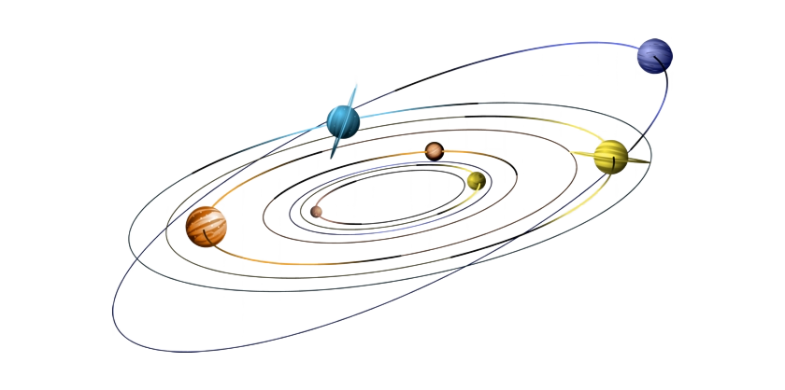
Brief History
The orrery, first created in 1713 for Charles Boyle, modeled the motions of planets around the Sun. Once mechanical, it has evolved into digital versions like **ASTRO ORRERY**, which now uses real-time NASA data to visualize planets and Near-Earth Objects, including asteroids and comets, with greater accuracy and interactivity.

Slide 4

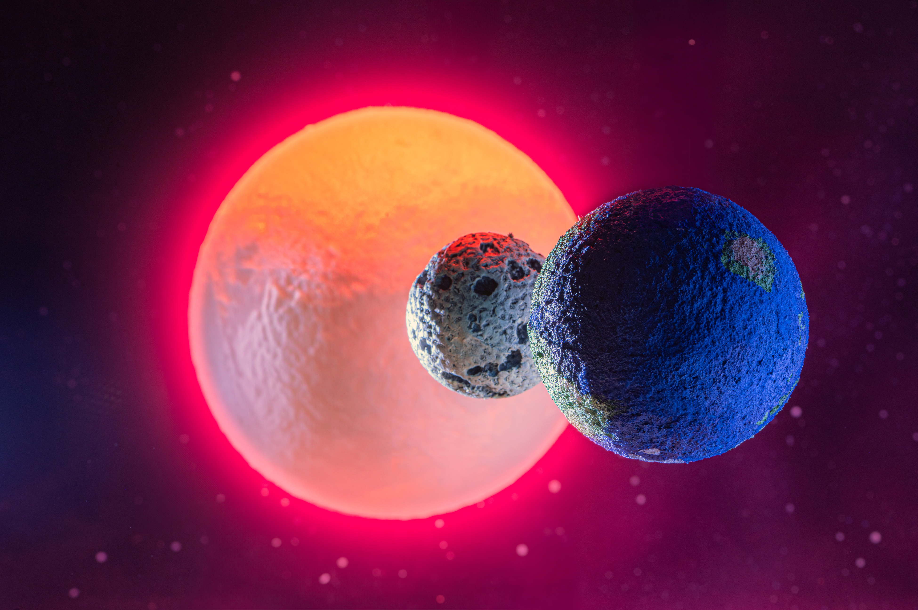

Vision
& Mission
Vision Statement
To create an interactive platform that combines historical orreries with modern technology, allowing users to explore and understand the movements of Near-Earth Objects in real time.
Mission Statement
To develop ASTRO ORRERY, a web app that visualizes Near-Earth Objects using real-time NASA data, offering an engaging and educational experience of space exploration for all users.

Slide 5


Features
3D Orrerey
Real-time Monitoring
Near Earth Objects
Provides a fully interactive 3D model of the solar system, allowing users to explore planetary positions and orbits.
Displays up-to-date data on celestial bodies, including planets and Near-Earth Objects, with live updates.
Tracks asteroids, comets, and potentially hazardous objects close to Earth, offering detailed information on their orbits and risks.

Slide 6
Thank You !
ASTRRIX

